Slide 1
Unit 9 Memory Unit and ALU

Slide 2
Arithmetic Logic unit
An arithmetic logic unit (ALU) is a multi operation, combinational-logic digital function.
It can perform a set of basic arithmetic operations like addition, subtraction, increment, decrement, transfer operations etc. and a set of logic operations such as AND,OR,NOT etc.
A
B
S
(
M
o
d
e
-
S
e
l
A
4
A
3
A
2
A
1
B
4
B
3
B
2
B
1
2
e
c
t
)
C
S
1
o
u
t
A
r
i
t
h
m
e
t
i
c
l
o
g
i
c
u
n
i
t
(
A
L
U
)
(
F
u
n
c
t
i
o
n
-
S
e
l
e
c
t
)
(
O
u
t
p
u
t
c
a
r
r
y
)
S
0
F
4
F
3
F
2
F
1
C
(
I
n
p
u
t
c
a
r
r
y
)
i
n
F
Fig : Block diagram of a 4-bit ALU

Slide 3
Design of Arithmetic Logic Unit
Design of ALU is carried out in 3 stages:
1. Design of Arithmetic unit
2. Design of Logic unit
3. Combining these two unit

Slide 4
Design of Arithmetic Unit
Consists of Parallel adder connected in cascade.
8 different arithmetic operations are:
1 Addition (A + B)
2. Addition with carry (A + B + 1)
3. A plus 1's complement of B (A +B’ )
4. Subtraction (A +B’+ 1)
5. Transfer A (E – A) (using B = 0)
6. Increment A (A + 1), B = 0
7. Decrement A (A – 1), B = 1
8. Transfer A (A), using B =1

Slide 5
A
B
A
B
C
o
u
t
P
a
r
a
l
l
e
l
a
d
d
e
r
C
i
n
=
0
C
o
u
t
P
a
r
a
l
l
e
l
a
d
d
e
r
C
i
n
=
1
F
=
A
+
B
F
=
A
+
B
+
1
.
A
d
d
i
t
i
o
n
.
A
d
d
i
t
i
o
n
w
i
t
h
c
a
r
r
y
A
B
A
B
C
o
u
t
P
a
r
a
l
l
e
l
a
d
d
e
r
C
i
n
=
0
C
o
u
t
P
a
r
a
l
l
e
l
a
d
d
e
r
C
i
n
=
1
F
=
A
+
B
F
=
A
+
B
+
1
.
A
p
l
u
s
1
'
s
c
o
m
p
l
e
m
e
n
t
o
f
B
4
S
u
b
t
r
a
c
t
i
o
n
A
0
A
0
C
o
u
t
P
a
r
a
l
l
e
l
a
d
d
e
r
C
i
n
=
0
C
o
u
t
P
a
r
a
l
l
e
l
a
d
d
e
r
C
i
n
=
1
F
=
A
F
=
A
+
1
.
T
r
a
n
s
f
e
r
A
.
I
n
c
r
e
m
e
n
t
A
A
A
l
l
1
'
s
A
A
l
l
1
'
s
C
o
u
t
P
a
r
a
l
l
e
l
a
d
d
e
r
C
i
n
=
0
C
o
u
t
P
a
r
a
l
l
e
l
a
d
d
e
r
C
i
n
=
1
F
=
A
–
1
F
=
A
7
.
D
e
c
r
e
m
e
n
t
A
.
T
r
a
n
s
f
e
r
A

Slide 6
Function table
Function select |  |  | Output equals | Function
S₁ | S₀ | C_{in}
0 | 0 | 0 | F = A | Transfer A
0 | 0 | 1 | F = A +1 | Increment A
0 | 1 | 0 | F = A + B | Add A and B
0 | 1 | 1 | F = A +B + 1 | Add A and B with Carry 1
1 | 0 | 0 | F=A+ B’ | Add A and 1’s complement of B
1 | 0 | 1 | F=A+B’+1 | Subtraction(A-B)
1 | 1 | 0 | F = A – 1 | Decrement A
1 | 1 | 1 | F=A | Transfer A

Slide 7
Inputs |  |  |  | Outputs
S1 | S0 | Ai | Bi | Xi | Yi
0 | 0 | 0 | 0 | 0 | 0
0 | 0 | 0 | 1 | 0 | 0
0 | 0 | 1 | 0 | 1 | 0
0 | 0 | 1 | 1 | 1 | 0
0 | 1 | 0 | 0 | 0 | 0
0 | 1 | 0 | 1 | 0 | 1
0 | 1 | 1 | 0 | 1 | 0
0 | 1 | 1 | 1 | 1 | 1
1 | 0 | 0 | 0 | 0 | 1
1 | 0 | 0 | 1 | 0 | 0
1 | 0 | 1 | 0 | 1 | 1
1 | 0 | 1 | 1 | 1 | 0
1 | 1 | 0 | 0 | 0 | 1
1 | 1 | 0 | 1 | 0 | 1
1 | 1 | 1 | 0 | 1 | 1
1 | 1 | 1 | 1 | 1 | 1
From truth table, using K map,
Xi=Ai
Yi=S0Bi+S1Bi’

Slide 8
S
B
S
0
i
0
S
1
B
A
i
i
S
B
1
i
'
X
Y
i
i
P
C
a
r
a
l
l
e
l
a
d
d
C
e
r
i
n
o
u
t
F
i
Fig: Single stage Arithmetic circuit

Slide 9
Design of logic unit
Design a logic circuit, which can perform following logic operation.
AND
OR
XOR
NOT
We require 4X1 Mux for 4 logical operations
Function table
 |  | Output (F) | Operation
S₁ | S₀
0 | 0 | A .B | OR
0 | 1 | A+B | XOR
1 | 0 | A ⊕ B | AND
1 | 1 | A’ | NOT

Slide 10
Function Table of MUX
The 4 gates generates 4 logic operations AND, OR,XOR and NOT
Two selection lines S0 and S1 in MUX selects one of the gates for output
S0 | S1 | F
0 | 0 | I0
0 | 1 | I1
1 | 0 | I2
1 | 1 | I3

Slide 11
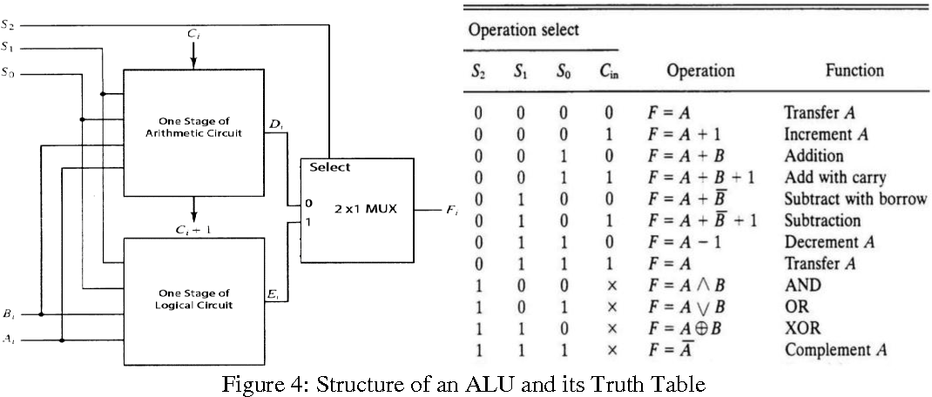
Design of Arithmetic Logic Unit

Slide 12
Status Register
Also called condition-code bits or flag bits.
The four status bits are : C, S, Z and V.

Slide 13
Carry bit (C) is set if the output carry of the ALU is 1. It is cleared if the output carry is 0.
Sign bit (S) is set if the highest- order bit of the result in the output of the ALU is 1. It is cleared if the highest-order bit is 0.
Zero bit (Z) is set if the output of the ALU contains all 0's and cleared otherwise.
Overflow bit(V) is set if exclusive - OR of carries C₈ and C₉ is 1, and cleared otherwise.

Slide 14
Shifter
The shift unit attached to a processor transfers the output of the ALU into the output bus
S₁ | S₀ | Operation | Function
0 | 0 | F ← A | Transfer A to S (No sift)
0 | 1 | F ← Shr A | Shift right A into F
1 | 0 | F ← Shl A | Shift left A into F
1 | 1 | F ← 0 | Transfer 0's into F
F
4
F
3
F
2
F
1
S
e
r
i
a
l
S
e
r
i
a
l
o
u
t
p
u
t
o
u
t
p
u
t
I
R
I
L
0
S
0
1
2
3
0
1
2
3
0
1
2
3
0
1
2
3
1
M
U
X
M
U
X
M
U
X
M
U
X
S
0
S
4
S
3
S
2
S
1
Fig.: 4-bit combination logic shifter

Slide 15
Processor Unit and Accumulator

